Slide 1



VIEWERSHIP ANALYSIS
Greenlighting Global Originals
Investment in Regional Content with
Global Breakout Potential
R
Rohit Patil
JUNE-2025

Slide 2


Executive Summary & Call to Action
Korean Thriller/Drama Series
Inspired by Squid Game's 265M+ views dominance
Genre-Bending Documentary/Reality Series
Emerging spikes in US, Brazil, and India
Spanish/French Action/
Heist Format
High retention and sustained Top 10 performance
Greenlight 3 Data-Informed International Original Pilots
Why Now: International hits like Squid Game, Money Heist, and Lupin have proven that local productions can become global franchises when they combine trending genres with strong storytelling.
Notes:
Immediate Action Items:
Korean Thriller/Drama Series - Inspired by Squid Game's 265M+ views dominance
Spanish/French Action/Heist Format - High retention and sustained Top 10 performance
Genre-Bending Documentary/Reality Series - Emerging spikes in US, Brazil, and India

Slide 3
The Global Opportunity International Content is Driving Netflix's Future
Key Market Drivers
Success Stories Prove the Model
The Pattern
Mature markets require fresh content to drive subscriber retention
Emerging markets show unprecedented engagement with localized content
Competition is intensifying from both regional and global platforms
Content that "travels well" commands premium marketing investment
Squid Game (Korea): Local thriller → Global phenomenon
Money Heist (Spain): Regional heist drama → International franchise
Lupin (France): Local mystery → Worldwide hit
Strong local storytelling + Universal themes + Trending genres = Global success

Slide 4

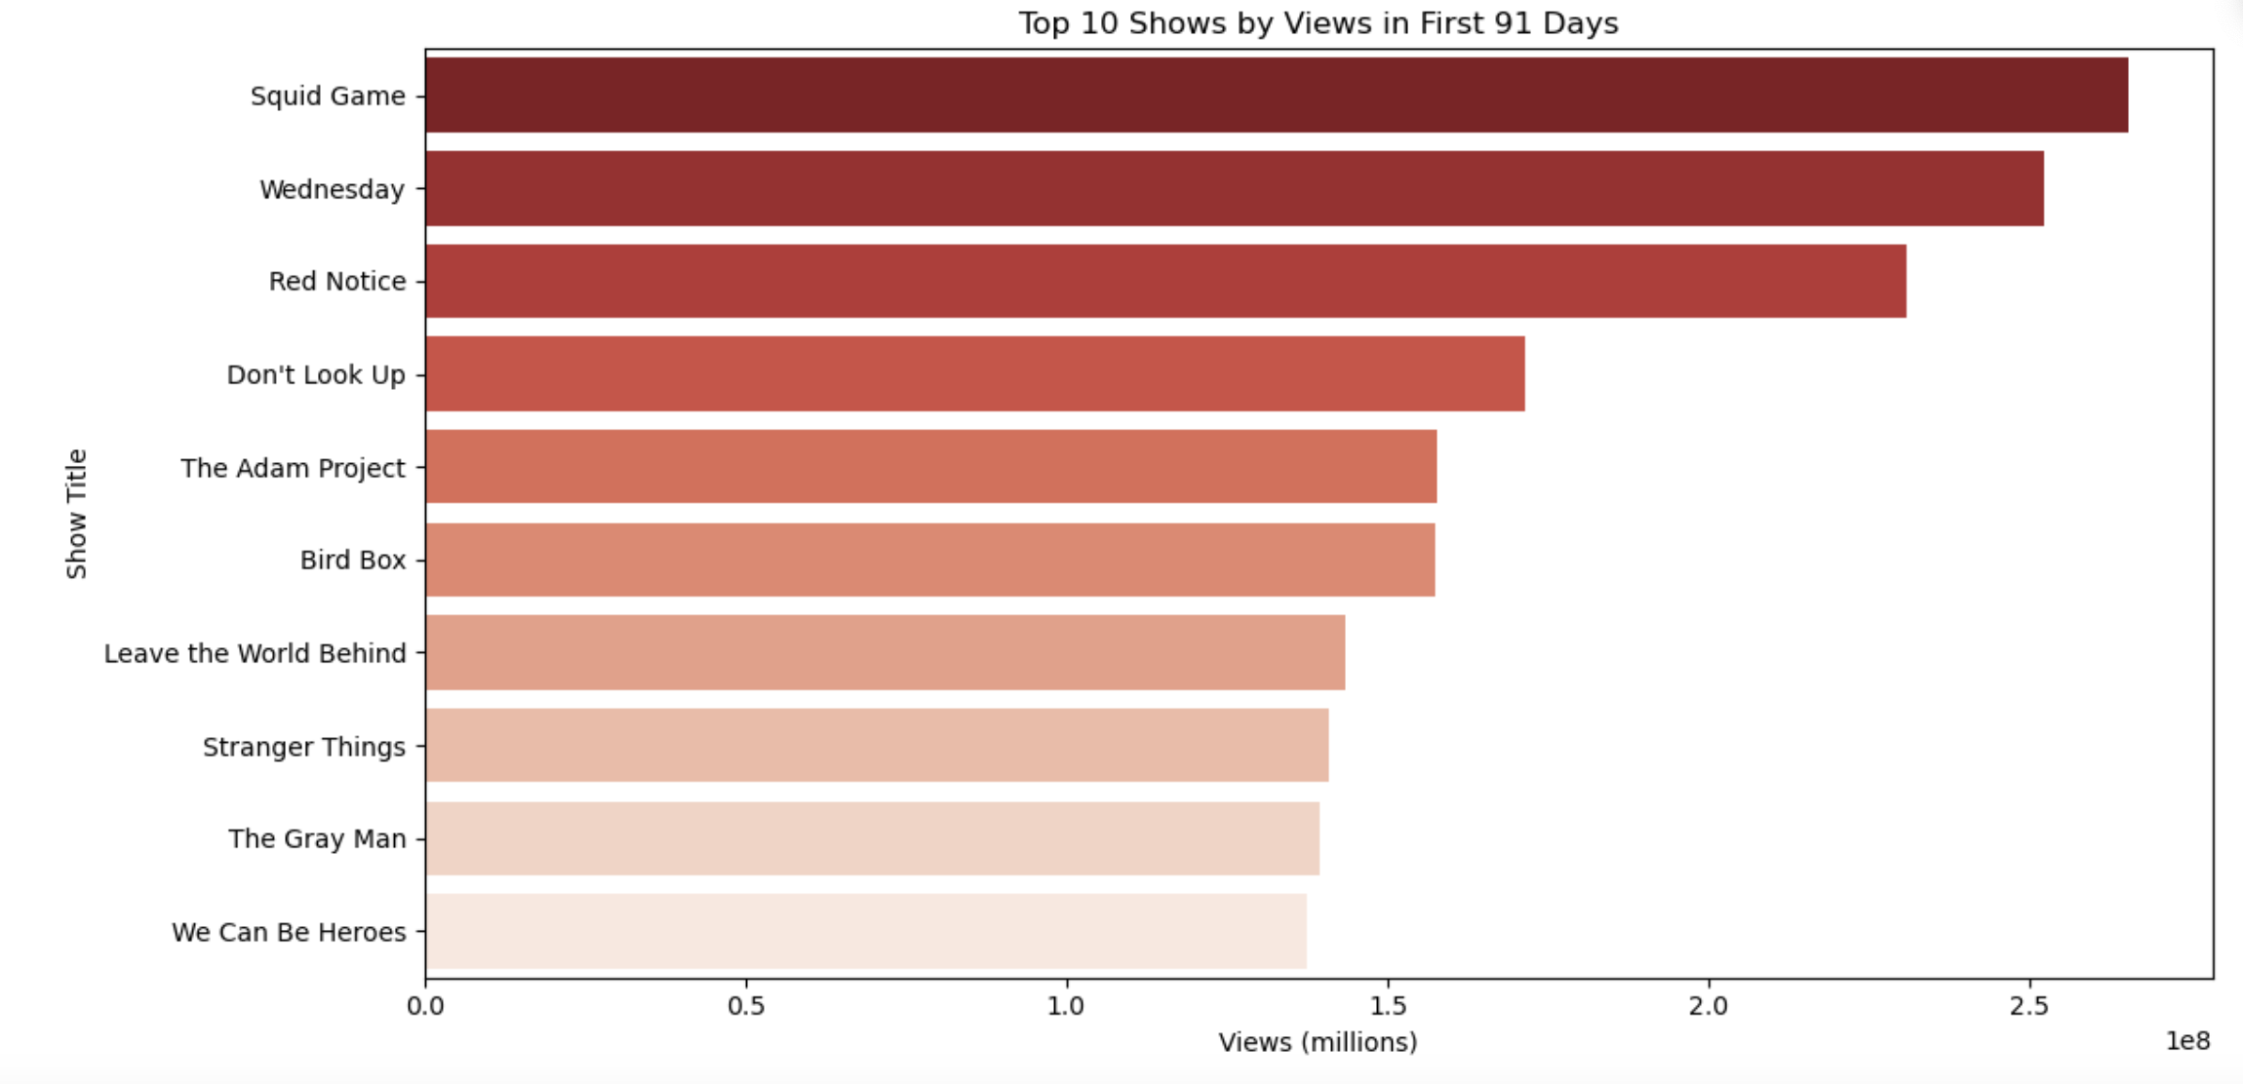
Data Deep Dive Top Performers Analysis
Views in First 91 Days Reveal Clear Winners
Dominant Performers -
Squid Game: ~265M views - Korean thriller/survival drama
Wednesday: ~250M views - Dark comedy/supernatural
Red Notice: ~215M views - Action/heist film
Don't Look Up: ~150M views - Satirical drama
The Adam Project: ~135M views - Sci-fi action
Key Insights:
Non-English content (Squid Game) can outperform major English productions
Genre diversity in top performers: thriller, supernatural, action, satire
Strong opening performance indicates viral potential and word-of-mouth amplification

Slide 5
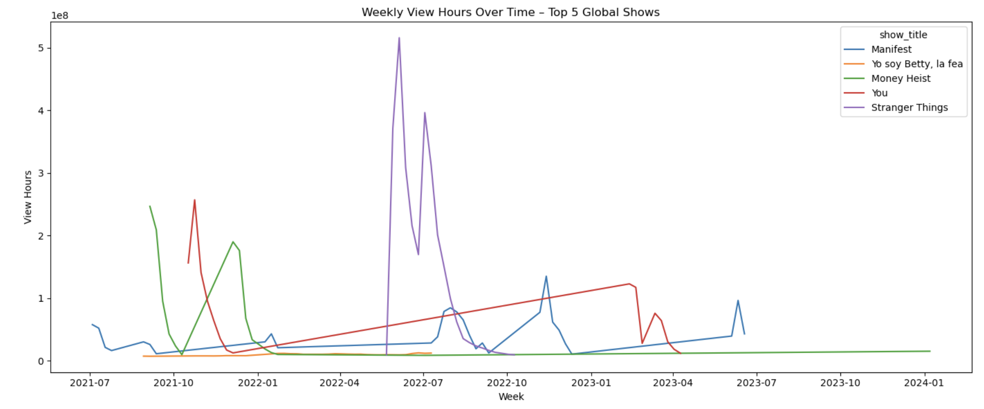
Sustained Engagement Weekly Performance Trends
Long-Term Viewership Patterns Show Content Staying Power
Weekly View Hours Over Time -
Stranger Things: Consistent long-term engagement with periodic spikes
Money Heist: Strong, sustained performance over multiple seasons
You: Steady growth pattern with strong retention
Manifest: Explosive growth followed by sustained interest
Strategic Implications:
Content with strong narrative arcs maintains viewer engagement
International content shows similar retention patterns to English content
Serialized formats drive longer platform engagement than standalone content

Slide 6
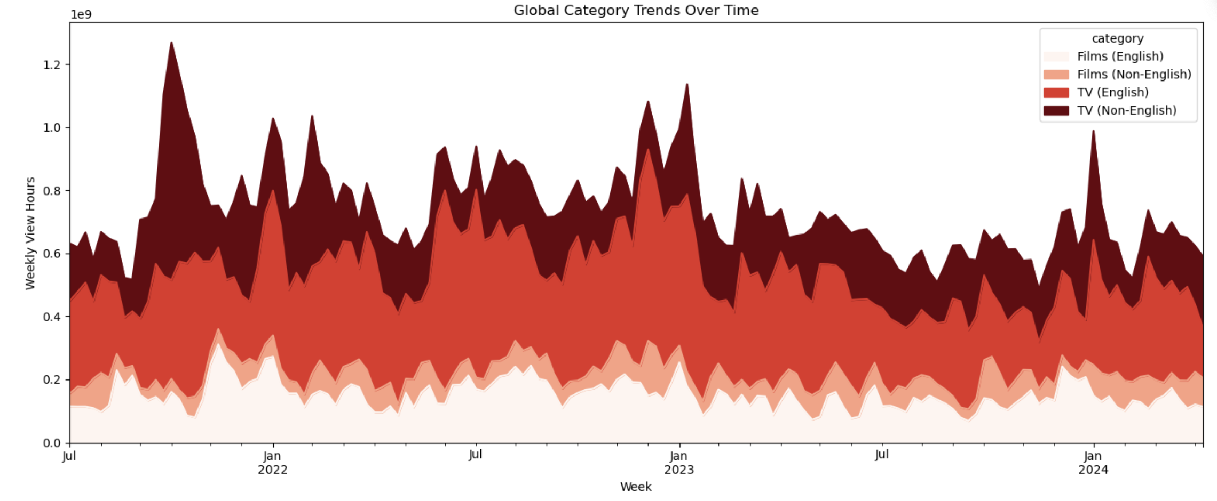
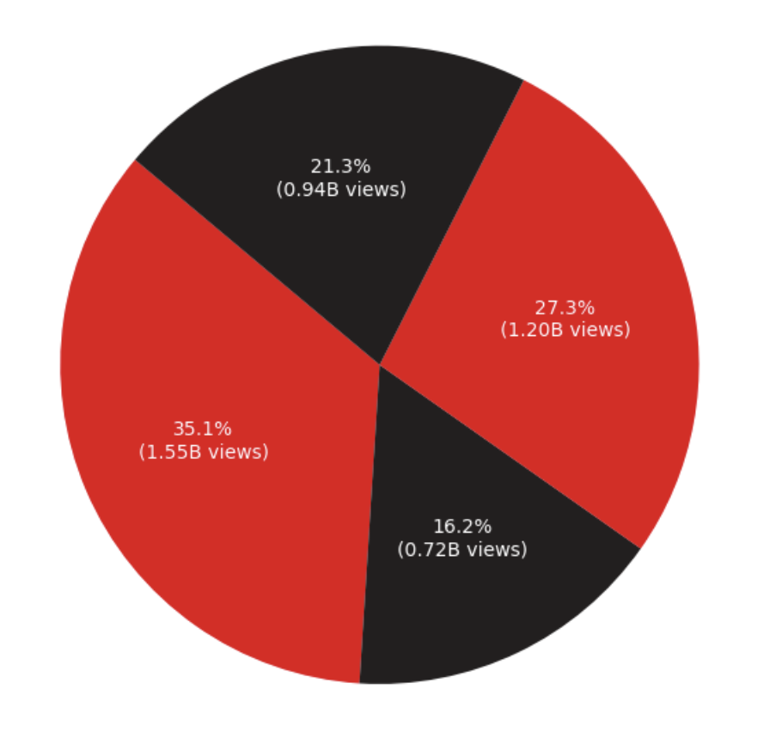
Category Performance Content Mix Strategy
Global Category Trends Reveal Shifting Viewer Preferences
Content Category Distribution -
TV Non-English: Showing the strongest growth trajectory
Films English: Maintaining a steady baseline performance
TV English: Consistent high performance
Films Non-English: A Growing segment with untapped potential
Market Share Breakdown :
TV English: 35.1% (1.55B views)
Films English: 27.3% (1.20B views)
TV Non-English: 21.3% (0.94B views)
Films Non-English: 16.2% (0.72B views)
Notes:
Opportunity: Non-English TV content represents fastest-growing segment with highest ROI potential

Slide 7
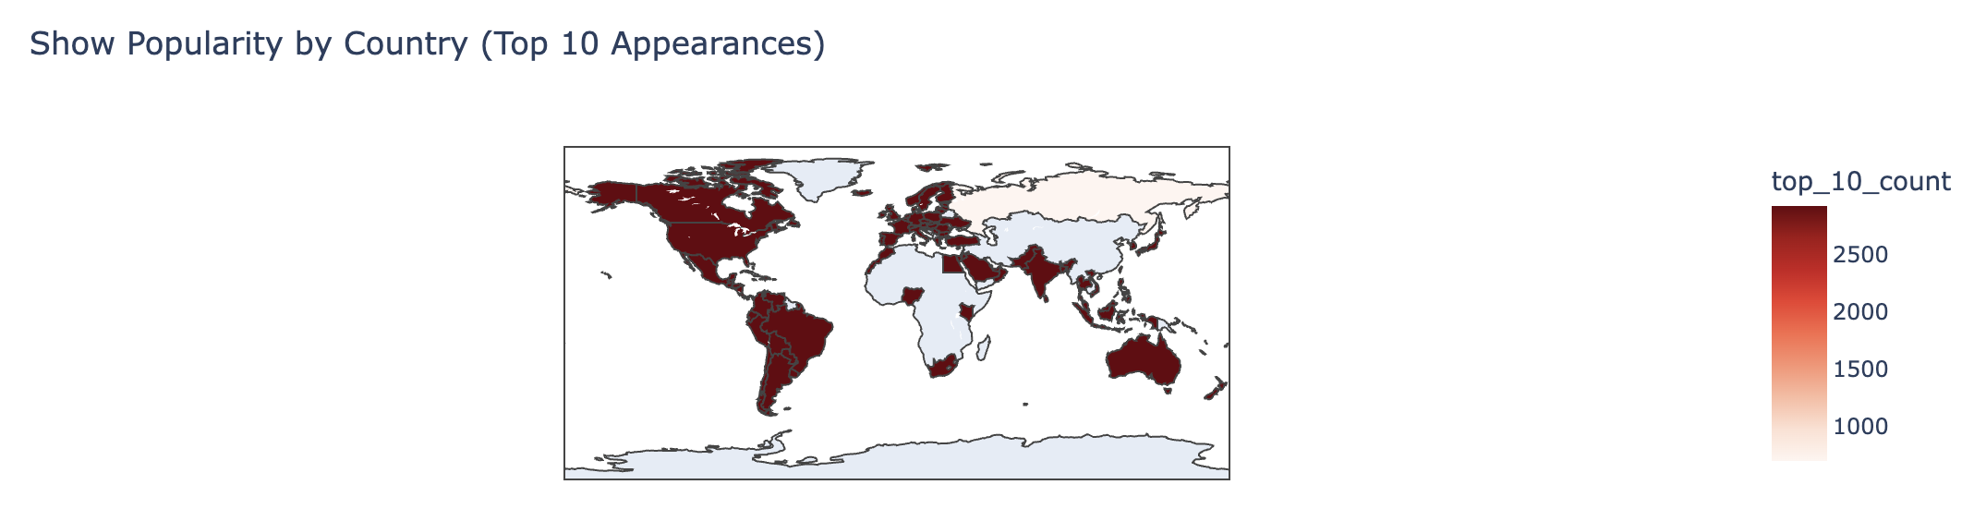
Geographic Distribution Global Reach Analysis
Show Popularity by Country Reveals Market Penetration
Global Heat Map -
Highest Engagement: North America, Western Europe, Brazil, India
Emerging Markets: Strong adoption in Latin America and Asia-Pacific
Untapped Potential: Eastern Europe and parts of Asia showing growth opportunity
Regional Content Strategy :
Content travels best when it originates from high-engagement markets
Local productions in emerging markets can capture both regional and global audiences
Geographic diversity in Top 10 appearances indicates cross-cultural appeal potential

Slide 8
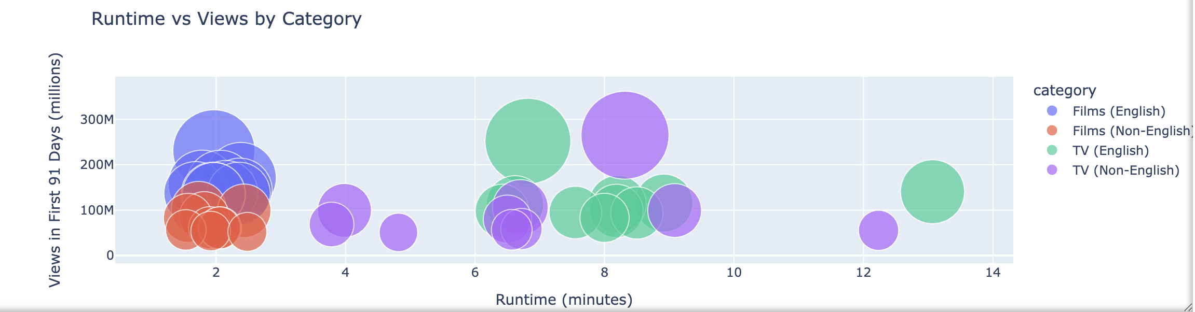
Content Performance Metrics Runtime vs. Viewership
Optimal Content Length for Maximum Engagement
Runtime vs Views by Category -
Sweet Spot: 6-8 hours total runtime shows the highest viewership
TV Series: Longer formats (8+ hours) can achieve massive scale
Films: 2–3-hour content performs well, but has a lower ceiling
Category Performance: Non-English TV shows strong correlation between runtime and views
Production Recommendations :
Target 6–8-episode series for new international content
Allow successful series to expand to longer formats
Focus on binge-worthy narrative structures

Slide 9
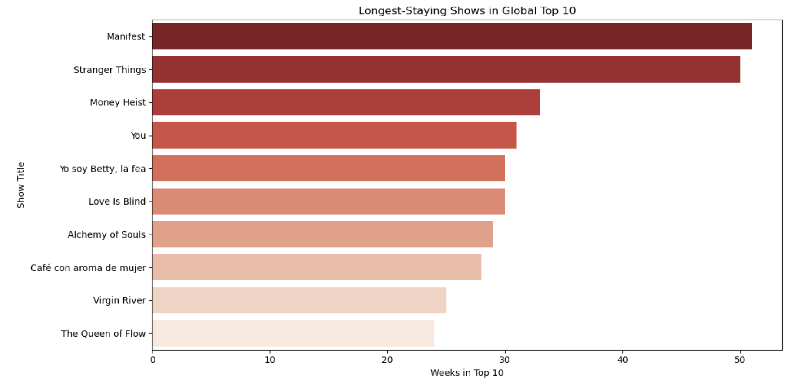
Longevity Analysis Sustained Performance Champions
Shows with Longest Top 10 Tenure Reveal Engagement Patterns
Longest-Staying Shows -
Manifest: ~50 weeks - Supernatural mystery with compelling mythology
Stranger Things: ~48 weeks - Nostalgic supernatural with strong characters
Money Heist: ~35 weeks - Complex heist narrative with emotional depth
You: ~32 weeks - Psychological thriller with seasonal renewal
Yo soy Betty, la fea: ~30 weeks - Telenovela format with universal themes
Content DNA for Longevity :
Strong character development and mythology
Serialized storytelling with cliffhangers
Universal themes within specific cultural contexts
Genre-bending elements that surprise audiences

Slide 10
Investment Thesis – Why International Originals Data-Driven Case for Regional Content Expansion
Financial Rationale
Risk Mitigation
ROI Multipliers
Lower production costs in emerging markets
Higher engagement rates for culturally relevant content
Reduced competition for local talent and stories
Premium global marketing amplification for breakout hits
Start with pilot productions to test market response
Partner with proven local production companies
Focus on genres with demonstrated cross-cultural appeal
Leverage data insights for content development decisions
Local success + Global breakout = Franchise potential
Cultural authenticity reduces content development risk
International awards and recognition drive premium positioning

Slide 11

Recommended Investment Strategy
Pilot 1: Korean Thriller/Drama Series
Rationale: Squid Game's unprecedented global success
Target: 6-8 episodes psychological thriller with social commentary
Investment: Partner with proven Korean production houses
Timeline: 18-month development to launch
Pilot 2: Spanish/French Action/Heist Format
Rationale: Money Heist's sustained global performance
Target: High-concept heist series with emotional depth
Investment: Bilingual production for broader appeal
Timeline: 15-month development cycle
Pilot 3: Genre-Bending Documentary/Reality Series
Rationale: Emerging viewer appetite in key markets (US, Brazil, India)
Target: Reality format with documentary storytelling elements
Investment: Multi-country production model
Timeline: 12-month fast-track development

Slide 12
Data Sources & Methodology
Data Sources:
Official Netflix viewership datasets (publicly released)
Global Top 10 weekly rankings
First 91 days viewing metrics
Geographic performance data by country
Analysis Methods:
Python-based data analysis (pandas, seaborn, matplotlib, plotly)
Conservative data handling with transparent filtering logic
Aggregate data protection (no individual viewer information)
Cross-validation of metrics across multiple data sources
Ethical Considerations:
No synthetic or fabricated data points
Transparent methodology for all calculations
Privacy-compliant aggregate reporting only
Conservative assumptions where data gaps exist

Slide 13

Thank
You

